Slide 1



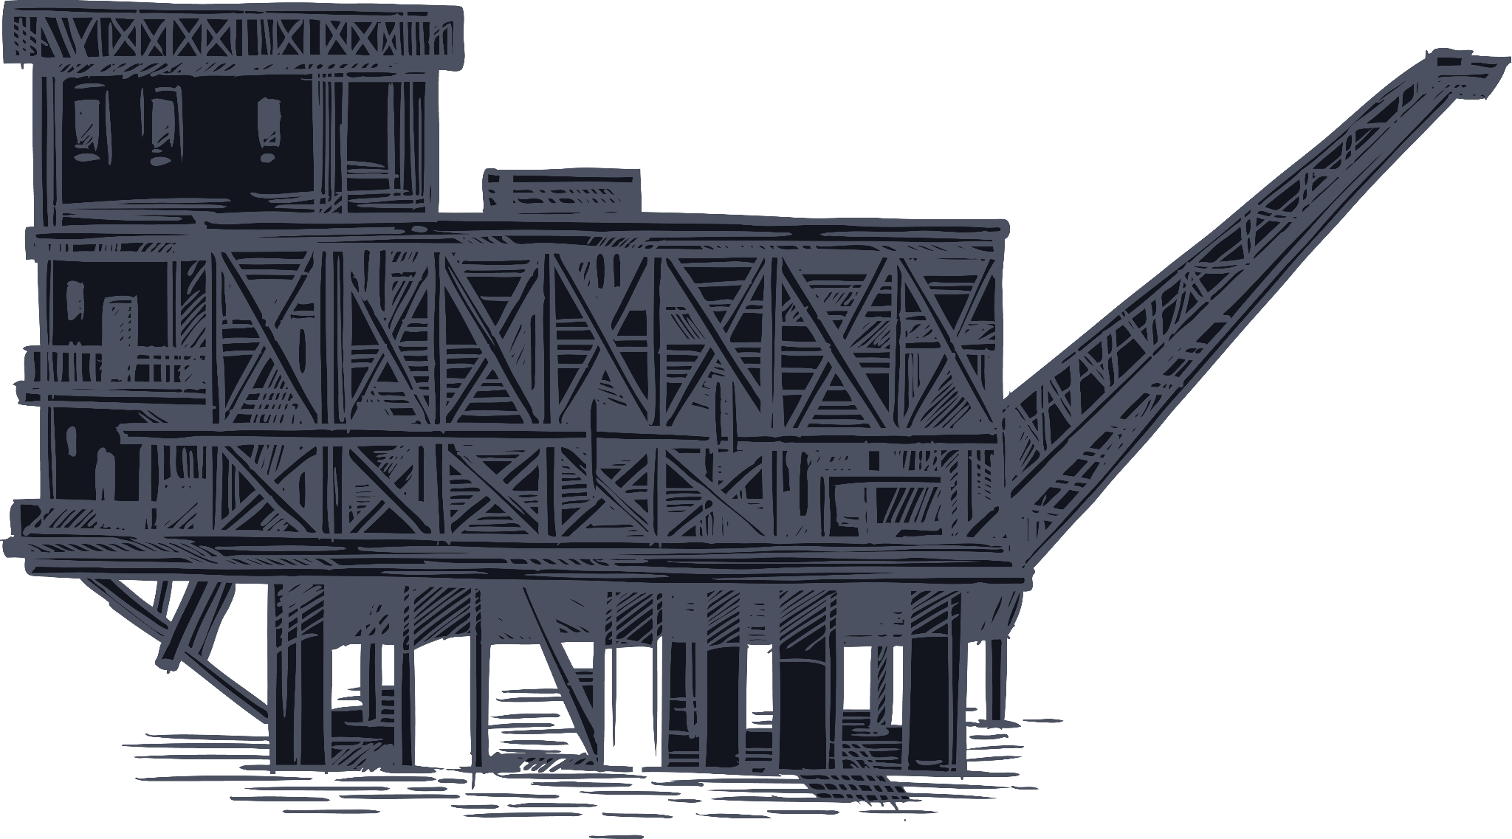

Hyperspectral Imaging For Oil Spill Detection
Checkpoint #3
Project #7
Team 8 Mehdi Nickzamir , Mohammad Sheikh
Supervisors: Luca Barco , Lorenzo Innocenti

Slide 2
Table of contents
01
02
03
04
05
06
Objectives
Research Questions
Value Proposition
method
experiment
Conclusions

Slide 3





01
Value Proposition

Slide 4

Value Proposition
LINKS Foundation: Develops and deploys innovative environmental monitoring technologies to support oil spill cleanup and remediation.
OIL AND SHIPPING COMPANIES: Provides an advanced analytics tool for early detection and precise monitoring of oil spills to mitigate liabilities.
ENVIRONMENTAL PROTECTION BODIES: Offers a data-driven system for real-time intelligence to enhance decision-making and resource allocation for oil spill impacts.

Slide 5
Table of contents
01
02
03
04
05
06
Objectives
Research Questions
Value Proposition
method
experiment
Conclusions

Slide 6


02
Objectives
: Main stakeholders

Slide 7
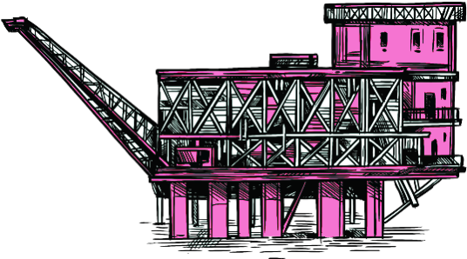
Objectives
Core Goal
Develop a Fully Connected Neural Network(FCNN) using hyperspectral remote sensing to ensure timely detection to reduce environmental and financial costs
Sub-Objectives:
Gather a robust dataset of hyperspectral images for oil spill detection.
Implement an innovative machine learning approach
Validate performance against state-of-the-art methods.

Slide 8
Table of contents
01
02
03
04
05
06
Objectives
Research Questions
Value Proposition
method
experiment
Conclusions

Slide 9
03
: Main stakeholders
Research Questions

Slide 10
Research questions
How effective are pseudo-labeled data to train supervised algorithms to detect HSI Images?

Slide 11
Research questions
How effective are pseudo-labeled data to train supervised algorithms to detect HSI Images?
How does applying outlier mitigation affect the accuracy?

Slide 12
Research questions
How effective are pseudo-labeled data to train supervised algorithms to detect HSI Images?
How does applying outlier mitigation affect the accuracy?
What neural networks can be utilized to achieve higher accuracy compared to the supervised approaches?

Slide 13
How effective are pseudo-labeled data to train supervised algorithms to detect HSI Images?
Research questions
How does applying outlier mitigation affect the accuracy?
What neural networks can be utilized to achieve higher accuracy compared to the supervised approaches?

Slide 14
Table of contents
01
02
03
04
05
06
Objectives
Research Questions
Value Proposition
method
experiment
Conclusions

Slide 15
04
method
: Main stakeholders

Slide 16
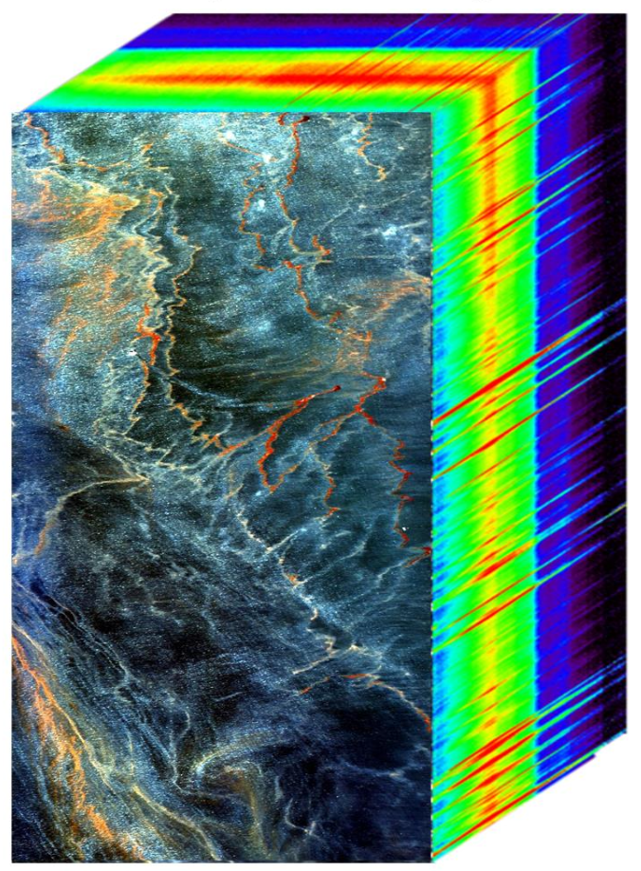
method
Labeled HSI Data of Mexican Gulf
PCA
Data Augmentation
Modified U-Net
Prediction
Pre Processing

Slide 17
method
PCA
Dimensionality Reduction
Mitigating Overfitting
Computational Efficiency
Noise Reduction
Why?
Mitigating Overfitting

Slide 18
method
PCA
Computational Efficiency
Noise Reduction
Dimensionality Reduction
Mitigating Overfitting
Why?
Dimensionality Reduction
Noise Reduction

Slide 19
method
Computational Efficiency
Why?
PCA
Dimensionality Reduction
Mitigating Overfitting
Noise Reduction
Mitigating Overfitting

Slide 20


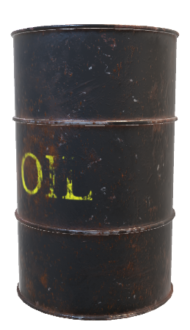
method
Data Augmentation
PCA
0.98
Mitigating Overfitting
13

Slide 21
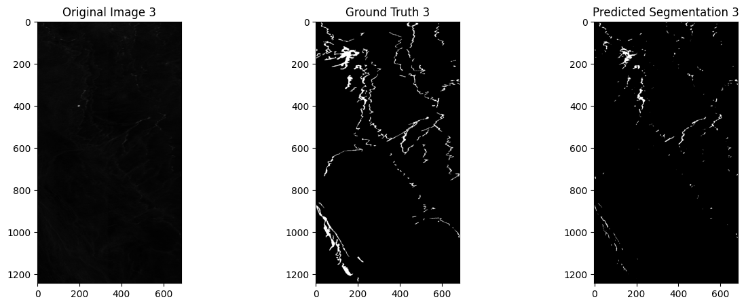
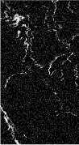
method
Data Augmentation
Rotation
Flipping
Translation
Gaussian Noise
PCA

Slide 22
method
Pre Processing
T1
T2
Image
T3
T4

Slide 23
method
Pre Processing
T1
T2
Image
T3
T4

Slide 24
method
Modified U-net
Pre Processing
Reflected
Image
T1
T1
T1
T1

Slide 25
method
Modified U-net
Why?
Pre Processing

Slide 26
method
Modified U-net
Simplicity and Adaptability
Ability to Capture
Non-linear Relationships
Why?

Slide 27
method
Modified U-net
High Dimensional Features
Efficiency and Performance
Ability to Capture
Non-linear Relationships
Why?

Slide 28

method
Modified U-net
High Dimensional Features
Efficiency and Performance
Ability to Capture
Non-linear Relationships
Why?

Slide 29
method
Modified U-net
Encoder Block 1
Encoder Block 2
Decoder Block 1
Decoder Block 2
Decoder Block 2
CNN
CNN
CNN
CNN
High Dimensional Features
Efficiency and Performance
Ability to Capture
Non-linear Relationships
Bottleneck
Output Layer
Channel Attention Mechanism (CAM)
CAM
Upsampling
Upsampling
CNN
Why?
Skip Connection
Skip Connection
1*1 CNN
CNN
Pooling Layer
Pooling Layer
CNN
CNN

Slide 30
Table of contents
01
02
03
04
05
06
Objectives
Research Questions
Value Proposition
method
experiment
Conclusions

Slide 31
05
: Main stakeholders
experiment

Slide 32
Model Performance
experiment
F1 Score
Precision
AUC
Accuracy

Slide 33
Model Performance
experiment
F1 Score
Precision
AUC
Accuracy

Slide 34
Model Performance
experiment
AUC
F1 Score
Precision
Accuracy

Slide 35
Model Performance
experiment
AUC
Precision
F1 Score
AUC
Accuracy
Precision

Slide 36
Model Performance
experiment
AUC
Accuracy
Recall
F1 Score
Recall
AUC
Precision

Slide 37
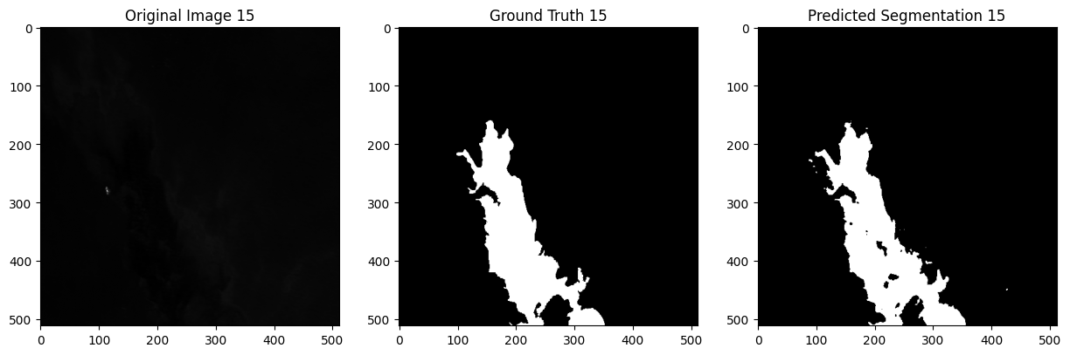
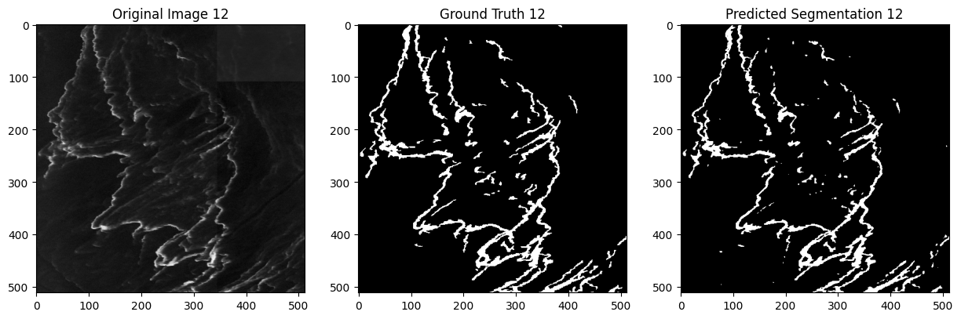
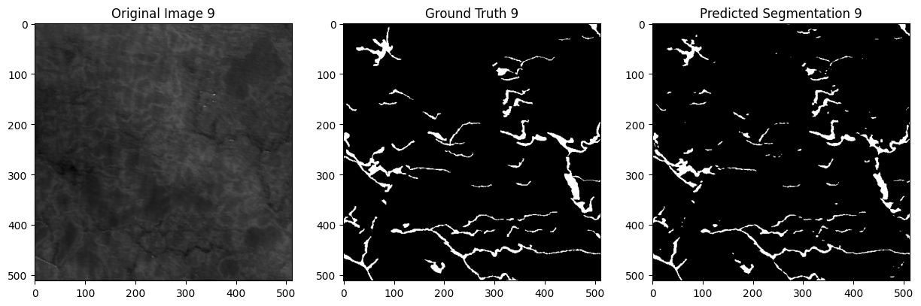
Visualization
experiment
AVG. F1 Score | AVG. Accuracy | AVG. AUC | AVG. Recall | AVG. Precision
0.7320 | 0.9832 | 0.8488 | 0.7032 | 0.8683

Slide 38
Visualization
experiment

Slide 39
Visualization
experiment

Slide 40
Visualization
experiment

Slide 41
Table of contents
01
02
03
04
05
06
Objectives
Research Questions
Value Proposition
method
experiment
Conclusions

Slide 42
06
: Main stakeholders
Conclusions

Slide 43
Conclusions
• Effectively reduced dimensionality using PCA
• Utilized Data Augmentation to make training data more robust
• Successfully classified hyperspectral images by applying 2D convolutional and Attention Mechanism

Slide 44


Directed by:
MEHDI NICKZAMIR
Executive Producer:
Prof. GIUSEPPE RIZZO
Associate Producers:
LUCA BARCO
S. MOHAMMAD S. AHMADI
LORENZO INNOCENTI
Jan - 2025

